Slide 1
Silicon Nitride Waveguides : Quantum Photonics
Presented By
Alok Anand
Electrical & Computer Engineering
April 26, 2022
MICRO AND NANO FABRICATION (18-615)
Professor Gianluca Piazza
Notes:
Main title: 40 pt. Arial
Presenter Name: 16 pt. Arial
Presenters Title: 16 pt. Arial Italic

Slide 2
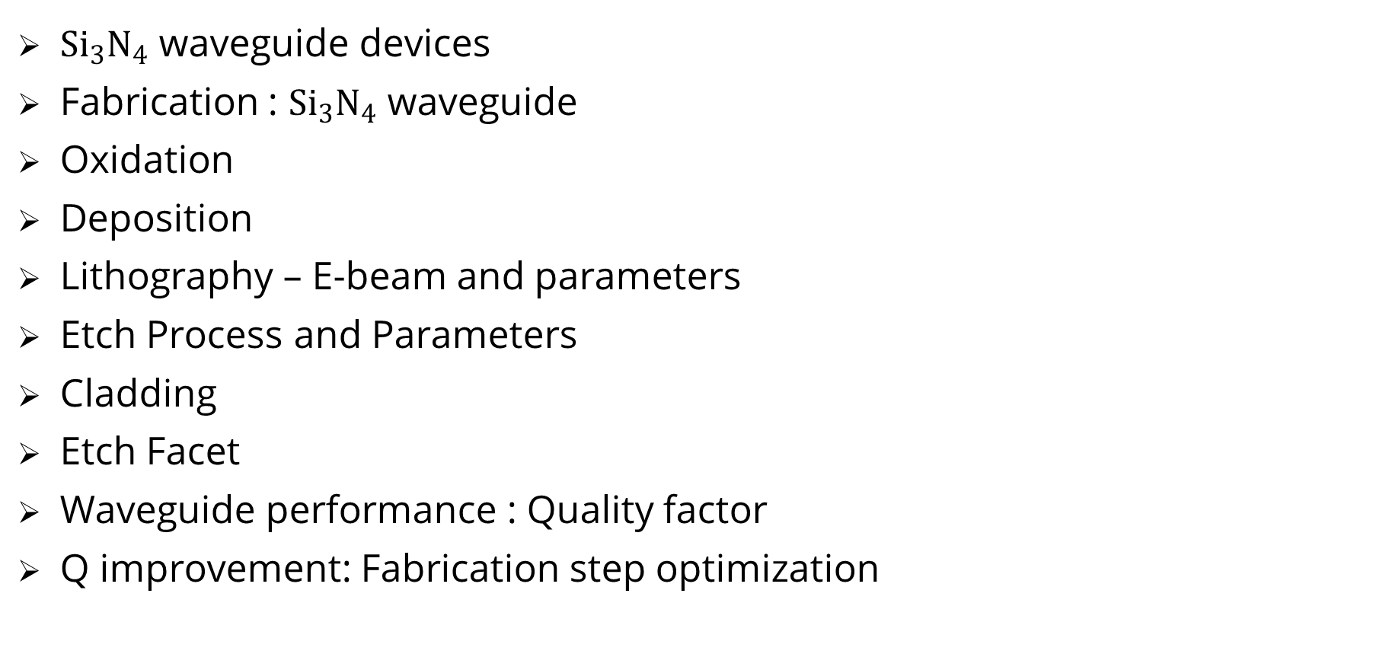
Content
${Si}_{3}N_{4}$ waveguide devices
Fabrication : ${Si}_{3}N_{4}$ waveguide
Oxidation
Deposition
Lithography – E-beam and parameters
Etch Process and Parameters
Cladding
Etch Facet
Waveguide performance : Quality factor
Q improvement: Fabrication step optimization

Slide 3
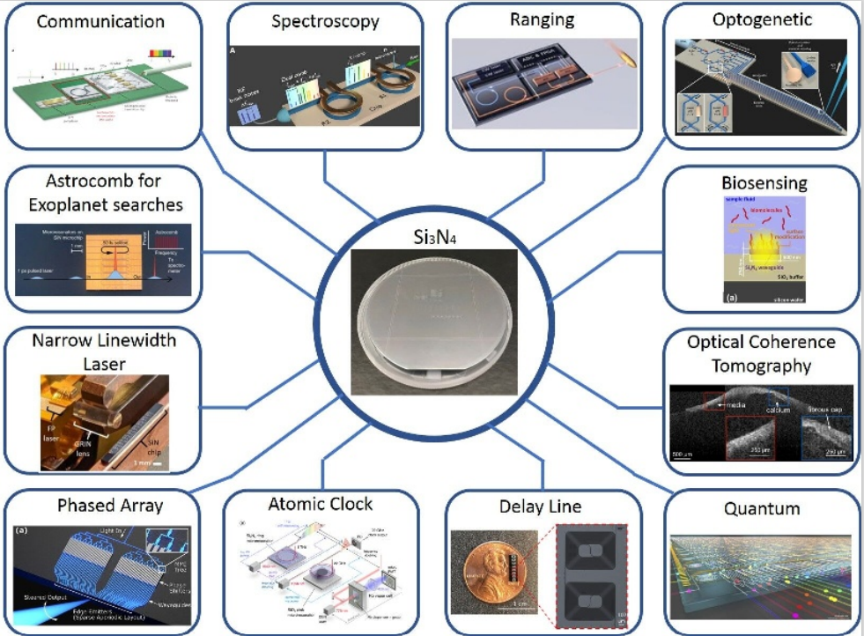

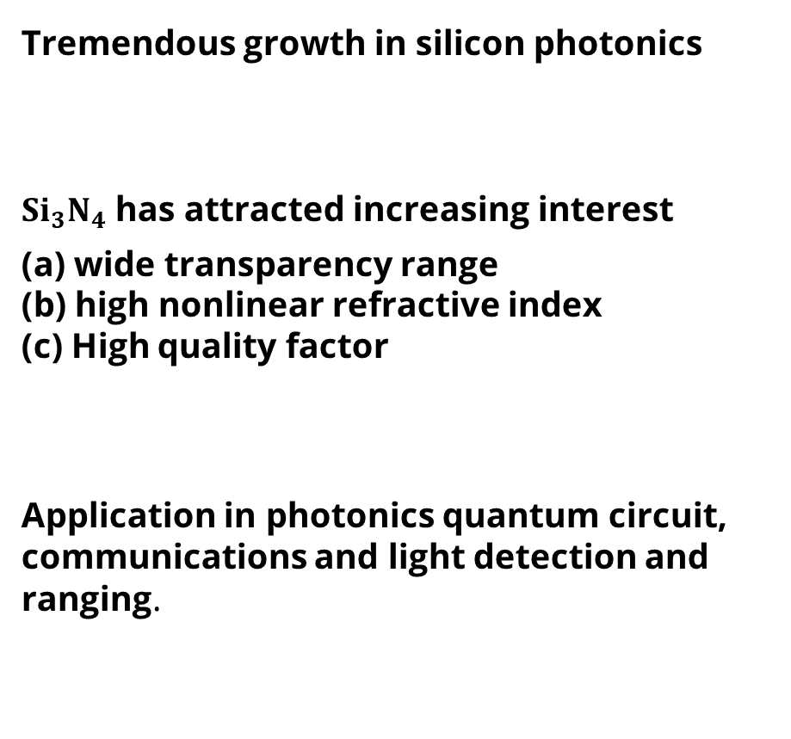
${Si}_{3}N_{4}$ waveguide devices
Tremendous growth in silicon photonics
${Si}_{3}N_{4}$ has attracted increasing interest
(a) wide transparency range (b) high nonlinear refractive index (c) High quality factor
Application in photonics quantum circuit, communications and light detection and ranging.

Slide 4
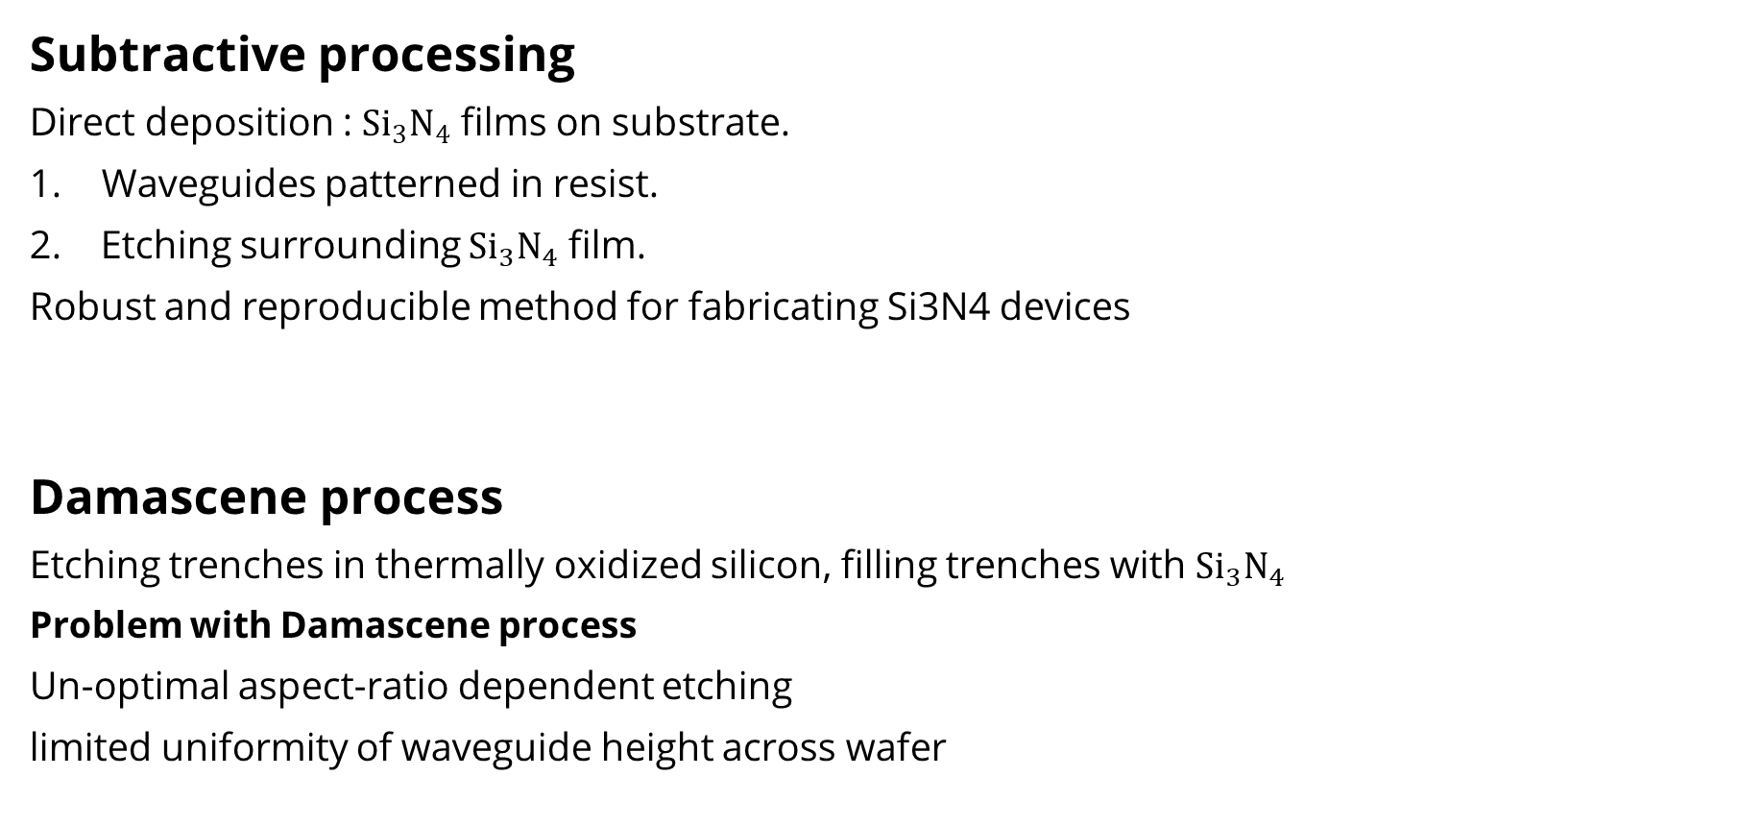
Fabrication : ${Si}_{3}N_{4}$ waveguide
Subtractive processing
Direct deposition : ${Si}_{3}N_{4}$ films on substrate.
Waveguides patterned in resist.
2. Etching surrounding ${Si}_{3}N_{4}$ film.
Robust and reproducible method for fabricating Si3N4 devices
Damascene process
Etching trenches in thermally oxidized silicon, filling trenches with ${Si}_{3}N_{4}$
Problem with Damascene process
Un-optimal aspect-ratio dependent etching
limited uniformity of waveguide height across wafer

Slide 5

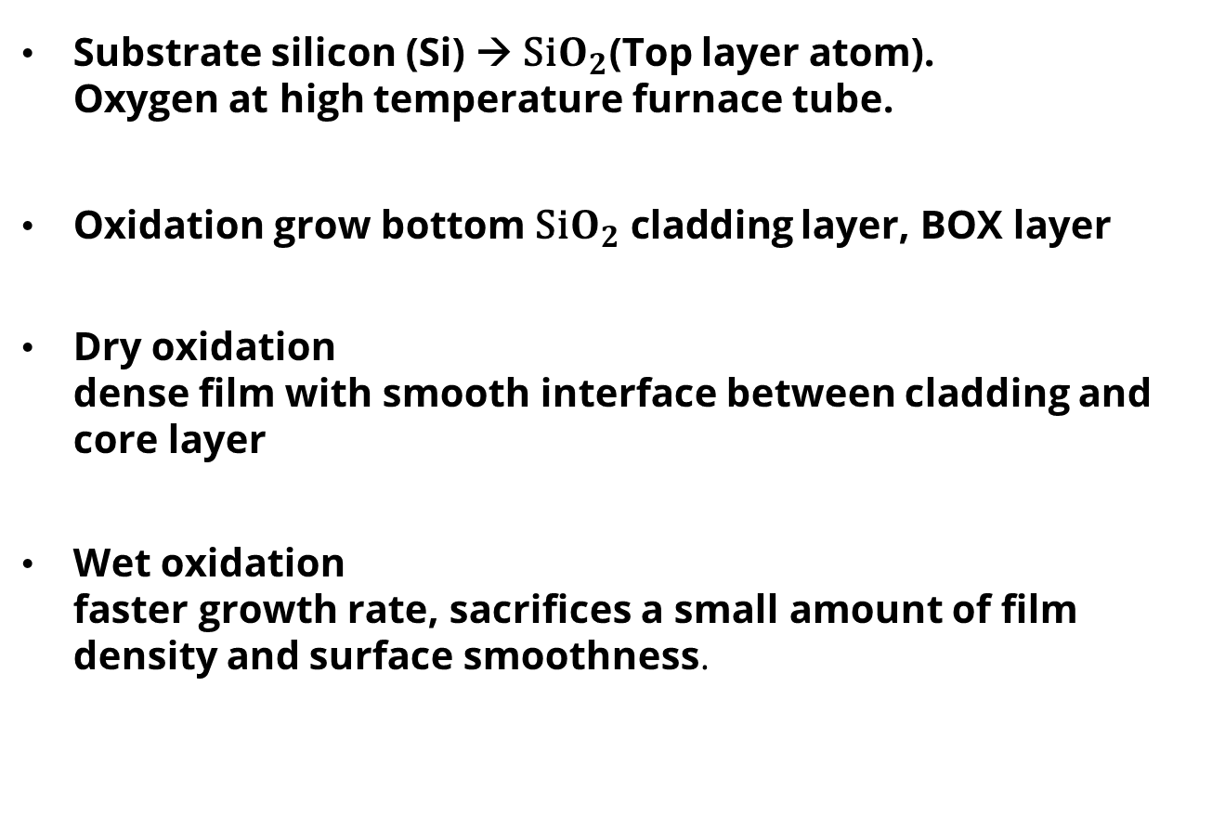
Oxidation
Silicon Substrate
Substrate silicon (Si) → Si$O_{2}$(Top layer atom). Oxygen at high temperature furnace tube.
Oxidation grow bottom Si$O_{2}$cladding layer, BOX layer
Dry oxidation dense film with smooth interface between cladding and core layer
Wet oxidation faster growth rate, sacrifices a small amount of film density and surface smoothness.
Silicon Oxide
Silicon Substrate

Slide 6
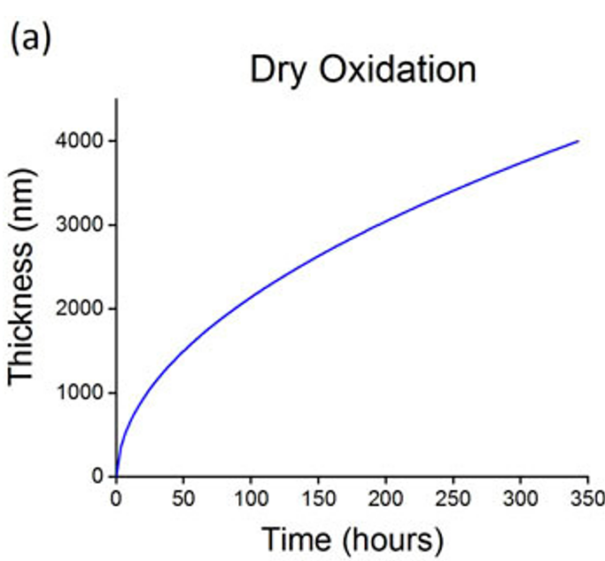
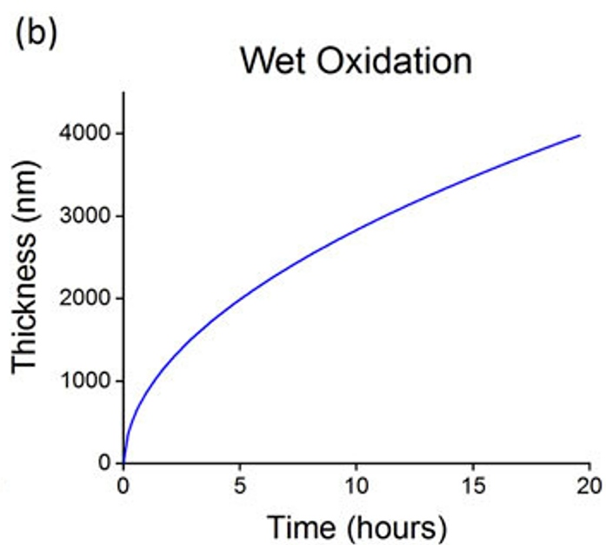
Oxidation Parameters
Oxide thickness as a function of time at 1200 °C. Dry oxidation : 4 µm oxide takes about 342 hours Wet oxidation : 4 µm oxide takes about 20 hours.
Effective approach Combining dry and wet oxidation at 1200 °C In Growth of 2-4 µm thick thermal oxide layer
Bottom cladding layer formed in less time, high quality and thick waveguide.

Slide 7
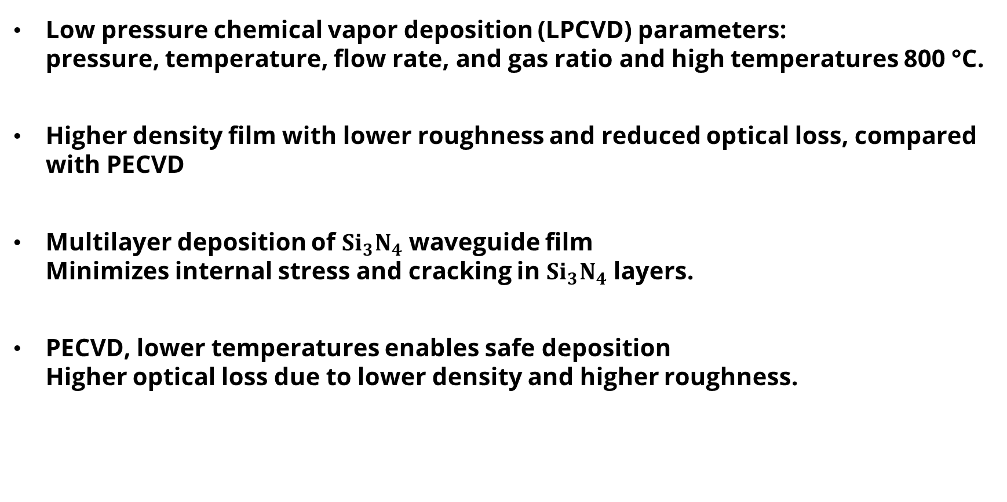
Deposition - LPCVD parameters
Low pressure chemical vapor deposition (LPCVD) parameters: pressure, temperature, flow rate, and gas ratio and high temperatures 800 °C.
Higher density film with lower roughness and reduced optical loss, compared with PECVD
Multilayer deposition of ${Si}_{3}N_{4}$ waveguide film Minimizes internal stress and cracking in ${Si}_{3}N_{4}$ layers.
PECVD, lower temperatures enables safe deposition Higher optical loss due to lower density and higher roughness.
Notes:
Lower temperatures enables safe deposition on temperature sensitive materials and devices, lower temperature deposition has the disadvantages of producing films with higher optical loss due to lower density and higher roughness.

Slide 8
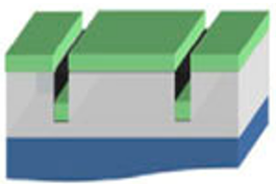
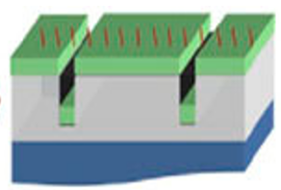
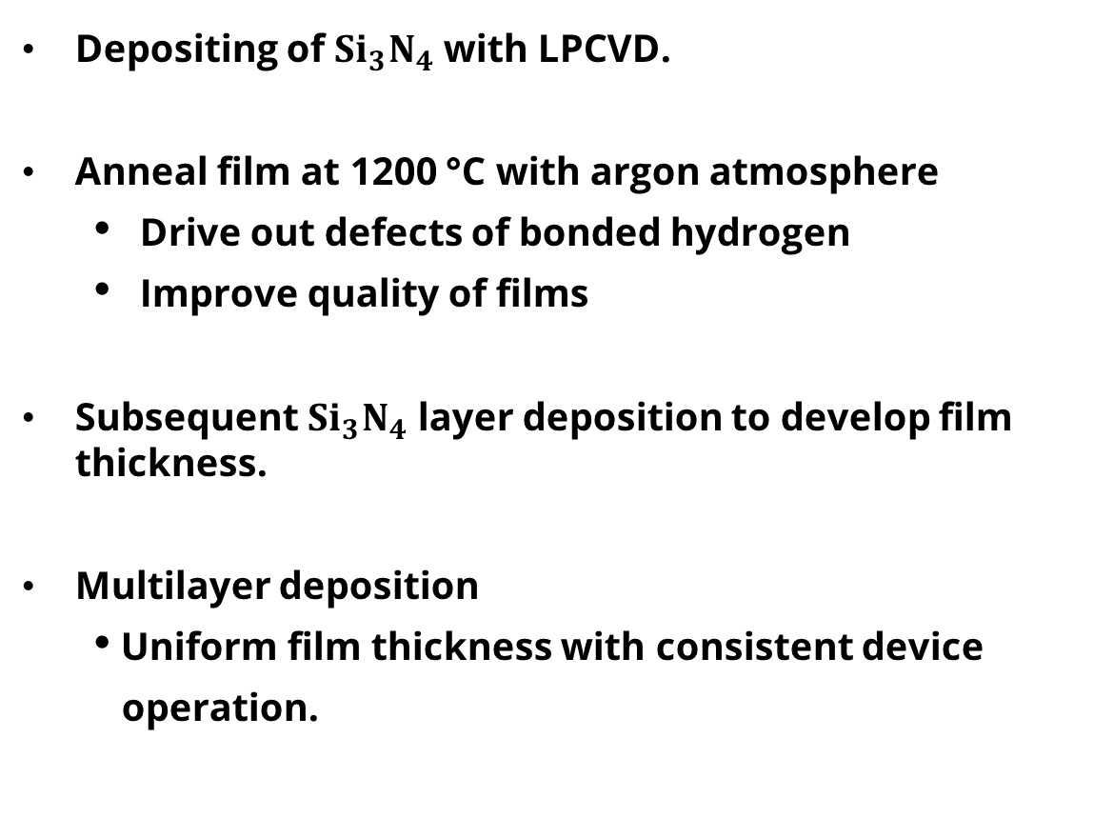
Deposition Process
Deposition
Depositing of ${Si}_{3}N_{4}$ with LPCVD.
Anneal film at 1200 °C with argon atmosphere
Drive out defects of bonded hydrogen
Improve quality of films
Subsequent ${Si}_{3}N_{4}$ layer deposition to develop film thickness.
Multilayer deposition
Uniform film thickness with consistent device
operation.
Annealing

Slide 9
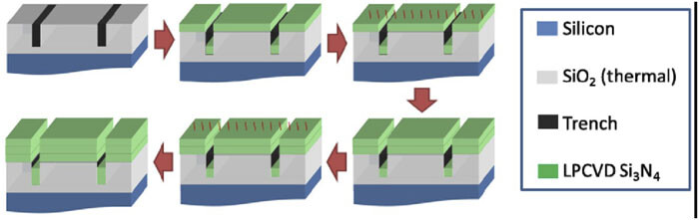

Deposition process flow
Trench formation Thermal oxidation
Depositing ${Si}_{3}N_{4}$ First layer → LPCVD
Annealing
Depositing Si3N4 Third layer → LPCVD
Annealing
Depositing Si3N4 Second layer → LPCVD

Slide 10
Lithography – E-beam and parameters
E-beam lithography :
Attain small feature sizes.
Maintain design flexibility
Available in research facilities
Parameters
Accelerating voltage : 100 kV
Beam current : maximum100 nA (maximum)
Clock speed : 100 MHz (maximum)

Slide 11
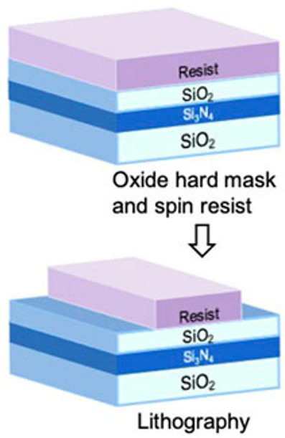
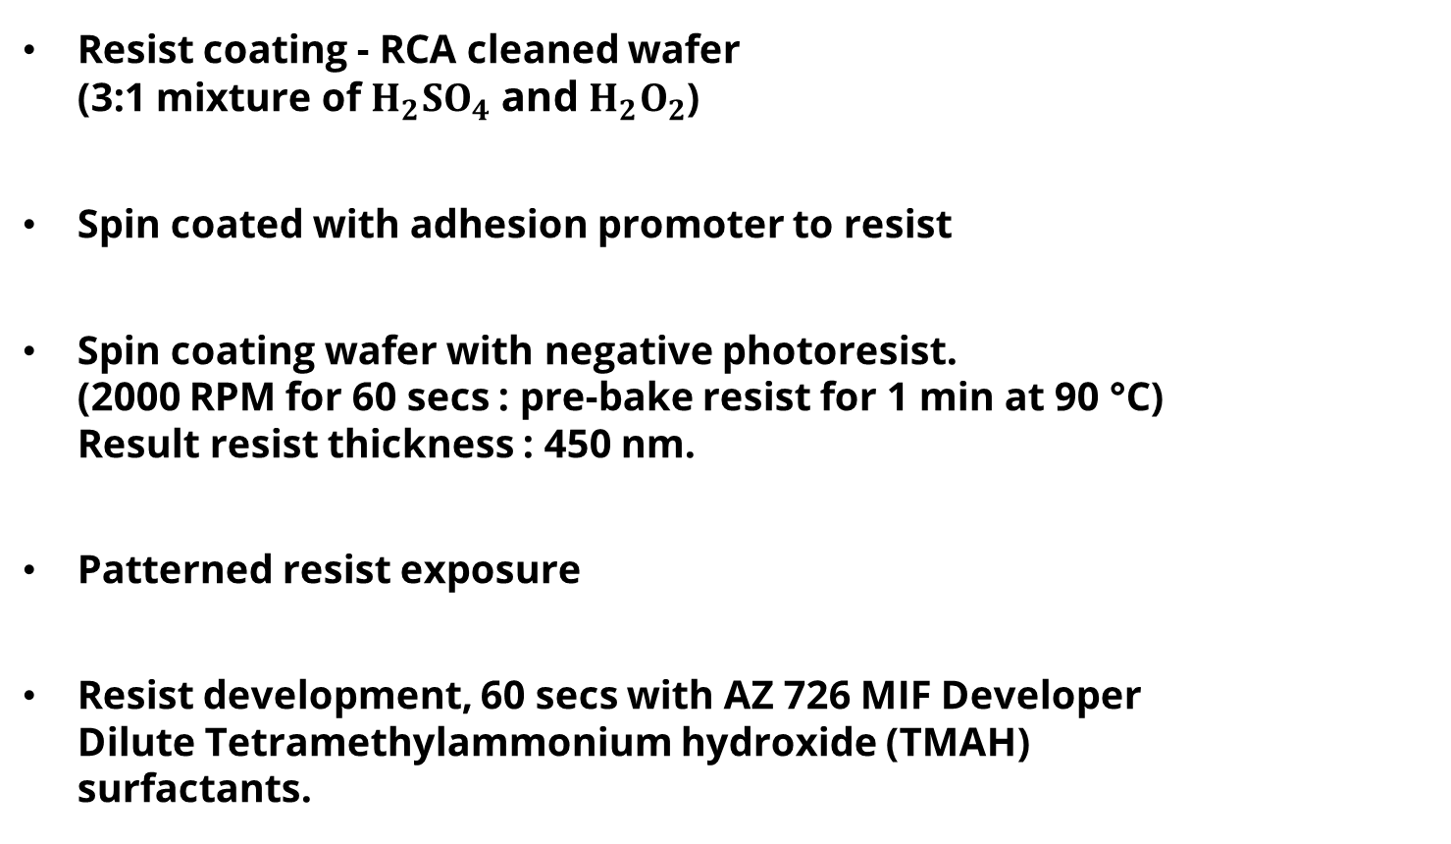
Lithography Process
Resist coating - RCA cleaned wafer (3:1 mixture of $H_{2}{SO}_{4}$ and $H_{2}O_{2}$)
Spin coated with adhesion promoter to resist
Spin coating wafer with negative photoresist. (2000 RPM for 60 secs : pre-bake resist for 1 min at 90 °C) Result resist thickness : 450 nm.
Patterned resist exposure
Resist development, 60 secs with AZ 726 MIF Developer Dilute Tetramethylammonium hydroxide (TMAH) surfactants.

Slide 12
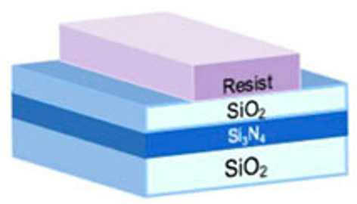
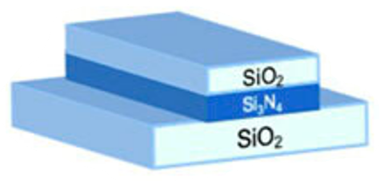
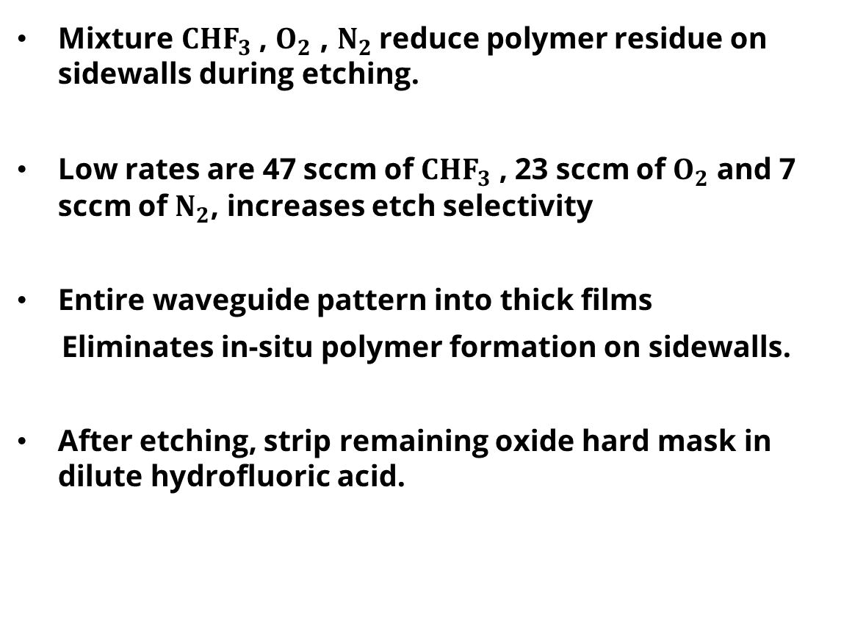
Etch Process and Parameters
Mixture ${CHF}_{3}$ , $O_{2}$ , $N_{2}$reduce polymer residue on sidewalls during etching.
Low rates are 47 sccm of ${CHF}_{3}$ , 23 sccm of $O_{2}$ and 7 sccm of $N_{2}$, increases etch selectivity
Entire waveguide pattern into thick films
Eliminates in-situ polymer formation on sidewalls.
After etching, strip remaining oxide hard mask in dilute hydrofluoric acid.

Slide 13
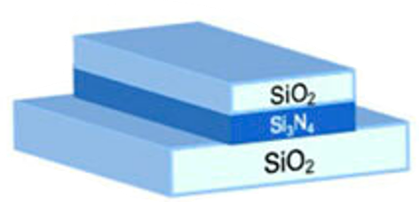
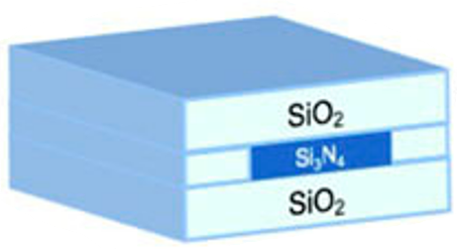
Cladding : Why LPCVD ?
ALD provides best uniformity,
Slow deposition speed
Good for very thin film deposition
PECVD provides a faster deposition rate at lower temperatures,
Less dense film with higher impurities inside film
less conformal process than LPCVD.

Slide 14
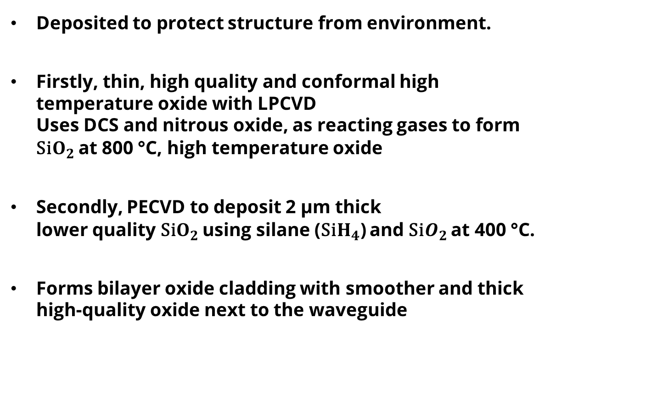
Cladding
Deposited to protect structure from environment.
Firstly, thin, high quality and conformal high temperature oxide with LPCVD Uses DCS and nitrous oxide, as reacting gases to form Si$O_{2}$ at 800 °C, high temperature oxide
Secondly, PECVD to deposit 2 µm thick lower quality Si$O_{2}$ using silane (Si$H_{4}$) and Si$O_{2}$ at 400 °C.
Forms bilayer oxide cladding with smoother and thick high-quality oxide next to the waveguide

Slide 15
Etch Facet
Packaging of the devices, wafer dicing
Introduce a roughness to the edge of the chip
Loss insertion in device coupled with cladding layer deposited on top of device.
Scalable and low-loss solution
Etching → smoother edge compared to direct dicing with less roughness variation
Photolithography → facets on all devices, wafer scale and mass fabrication

Slide 16
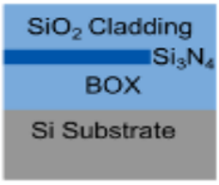





Etch Facet
Photoresist
Patterned resist
Coat and pattern photoresist
Leaving gap between
Patterned facet edge
and nanotaper tip
Coupling Facet
Etched Trench
Etched
Oxide
Photoresist removed
wafer separated
Etch cladding and bottom oxides

Slide 17
Waveguide performance : Quality factor
Quality factor (Q), measures sharpness of resonance relative to its central frequency
Laser scanning technique
Measure transmission spectra and linewidth of resonator (FWHM)
Photon lifetime by cavity ringdown
Includes repeatedly scanning laser into resonance.
power transfer increases to maximum at resonant mode

Slide 18
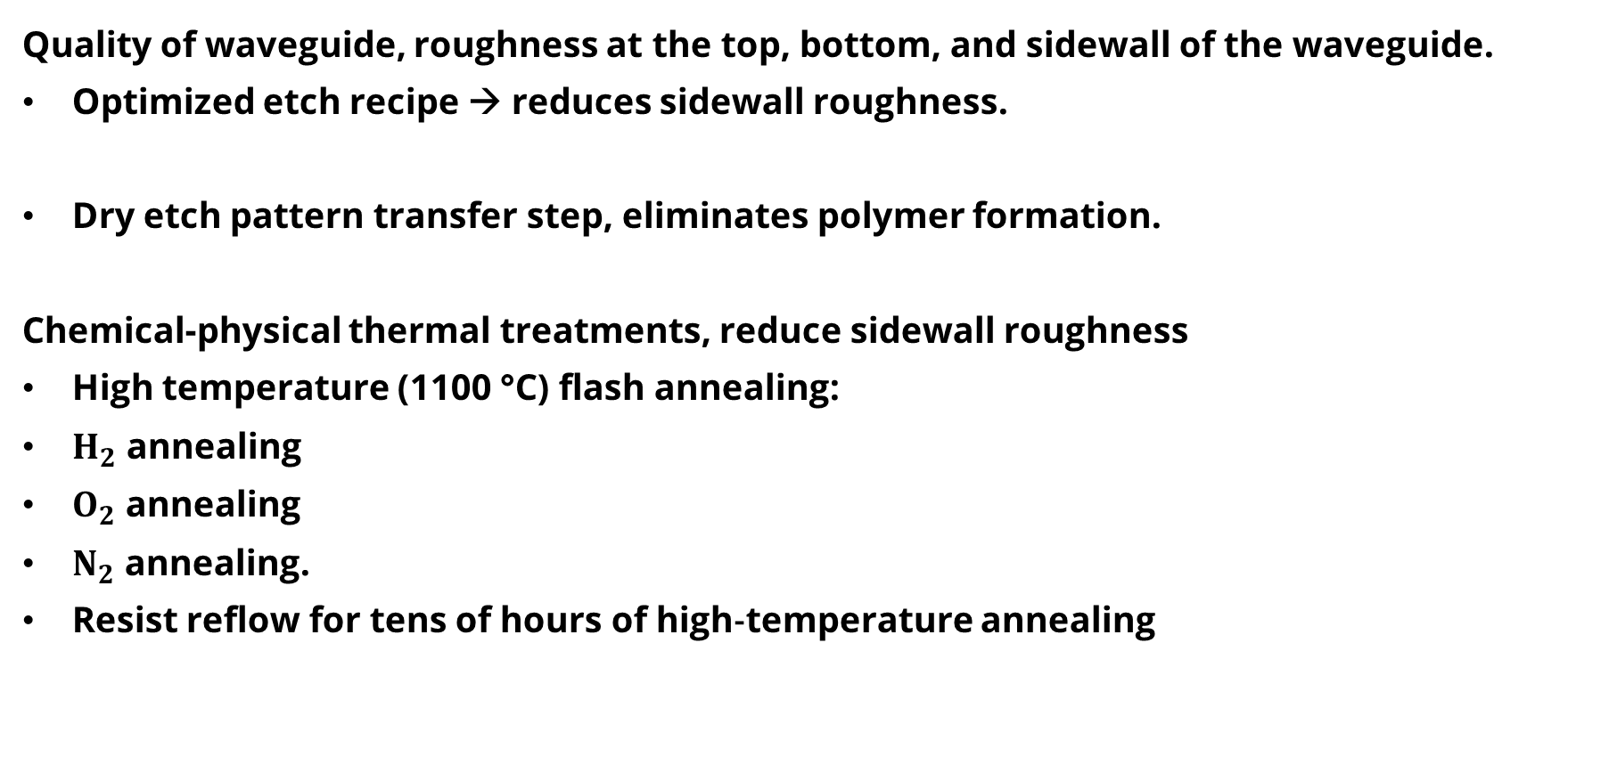
Q improvement – Etch step
Quality of waveguide, roughness at the top, bottom, and sidewall of the waveguide.
Optimized etch recipe → reduces sidewall roughness.
Dry etch pattern transfer step, eliminates polymer formation.
Chemical-physical thermal treatments, reduce sidewall roughness
High temperature (1100 °C) flash annealing:
$H_{2}$ annealing
$O_{2}$ annealing
$N_{2}$ annealing.
Resist reflow for tens of hours of high‐temperature annealing

Slide 19
Q improvement –Lithography step
Electron-beam lithography, causes line edge roughness.
Introduces extra roughness to the sidewalls
Instability like beam current fluctuations
Beam jitter
Beam drift
Stage position errors
Mechanical vibrations, can generate statistical errors
Result in extra line edge roughness in the patterns
Add roughness to the sidewalls

Slide 20
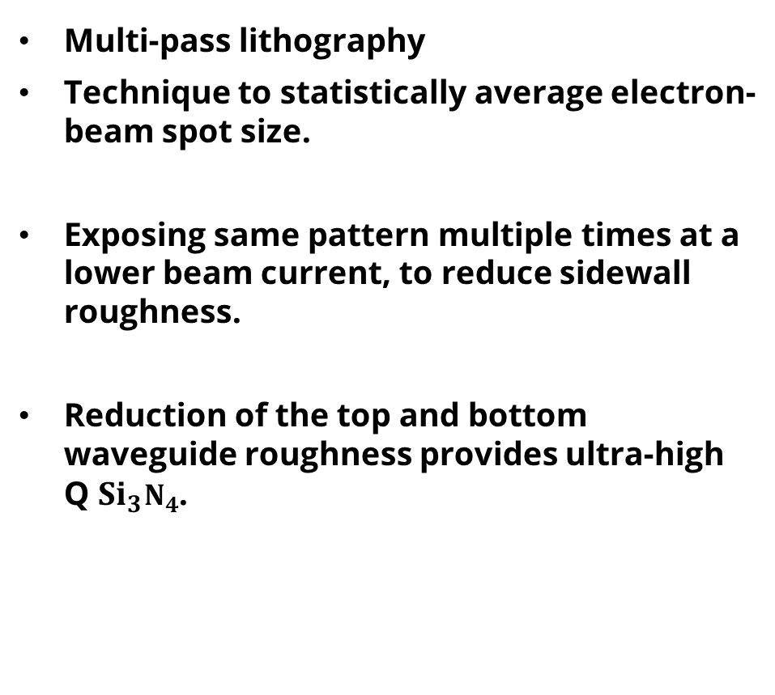
Q improvement –Lithography optimization
Multi-pass lithography
Technique to statistically average electron-beam spot size.
Exposing same pattern multiple times at a lower beam current, to reduce sidewall roughness.
Reduction of the top and bottom waveguide roughness provides ultra-high Q ${Si}_{3}N_{4}$.

Slide 21
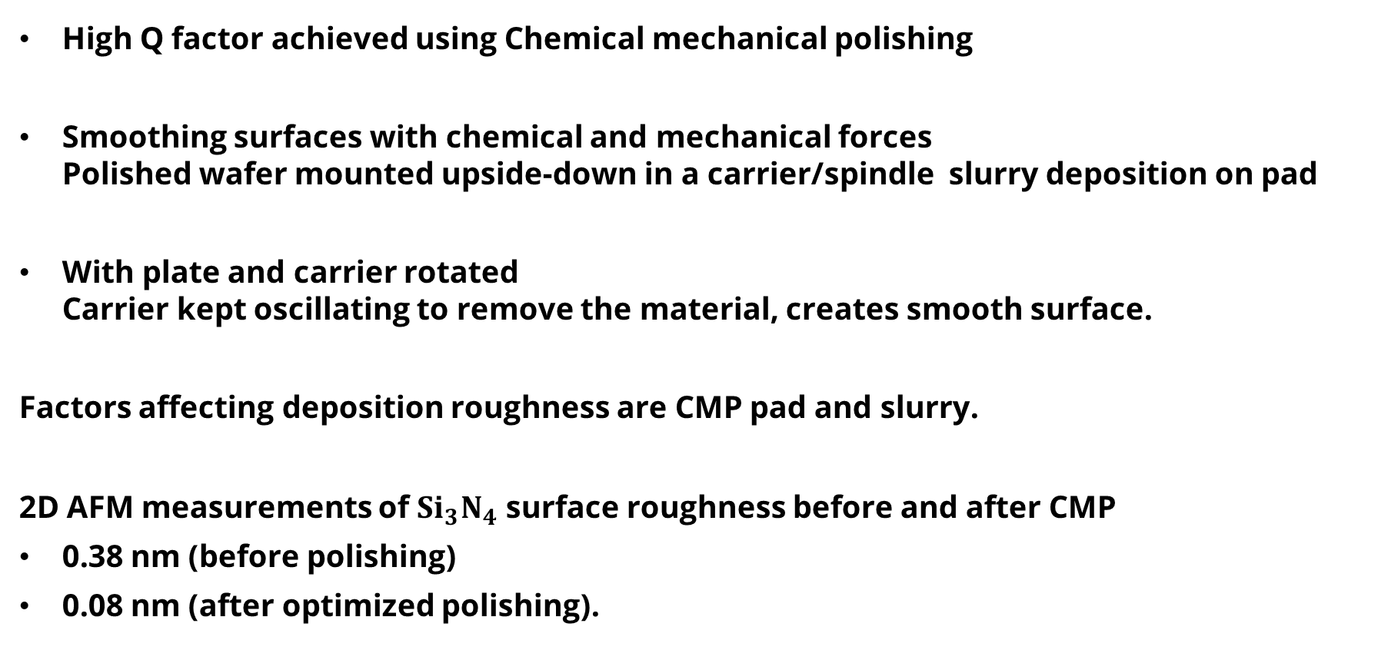
Q improvement - fabrication optimization
High Q factor achieved using Chemical mechanical polishing
Smoothing surfaces with chemical and mechanical forces Polished wafer mounted upside-down in a carrier/spindle slurry deposition on pad
With plate and carrier rotated Carrier kept oscillating to remove the material, creates smooth surface.
Factors affecting deposition roughness are CMP pad and slurry.
2D AFM measurements of ${Si}_{3}N_{4}$ surface roughness before and after CMP
0.38 nm (before polishing)
0.08 nm (after optimized polishing).

Slide 22
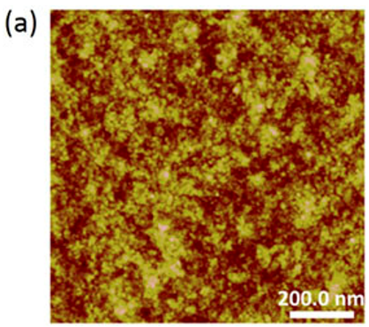
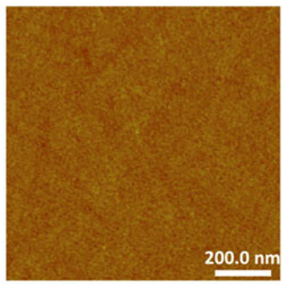
Q improvement - fabrication optimization
(b)
_{2D AFM scan}
Top surface of Si3N4 before polishing
_{2D AFM scan}
Top surface of Si3N4 after polishing

Slide 23
THANK YOU !!

